Slide 1
Agile - PLM Modernization & Simplification

Slide 2
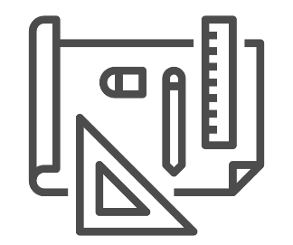
Agenda
Introduction
Agile PLM Modernization
Agile Kafka Enablement
Digital Transformation Journey
AGILE API Service Layer
File download API
File upload API
API Market Place Integration
Stoplight documentation enabled
Accelerated File Transfer – Attachment Utility

Slide 3
Dell Agile PLM Implementation
PC - Product Collaboration
Product Quality Management
Product Portfolio Management
Product Governance & Compliance
Product Lifecycle Analytics
Product Cost Management
Engineering collaboration
Agile integration services
Agile PLM
PC
PPM
OPLA
PCM
PQM
PG&C
EC

Slide 4
NorthStar Strategy
Focus Areas
- Unified Reporting
- Secure Access Layer
- Business One stop shop for PLM UI/Dashboard
Core Team
Cuong, Vijayendra
Focus Areas
Scalable service layer (Microservices / APIs)
Kafka Messaging Enablement
Standard integration framework –
Data Migration Tools
Core Team
Cuong, Ram
User Access &
Reporting
Layer
Integration &
Service
Layer
Oracle PLM Core
PC
PPM
EC
PCM
PQM
PG&C
Focus Areas
PCF/IaaS migration
Reduce Infrafootprint
Seamless DR
Infra self service portal
Reduce patch/RUP cycle time
Make security part of Dev cycle
DevOps Maturity to 90%
Core Team
Cuong, Naveen/ Mahendra/Deepak
Platform
Management &
Security
Focus Areas
Reducing the customization footprint.
Technology stack consolidation
File Transfer Modernization
Build self healing / support tools
PLM Consolidation (SAP & Agile)
Core Team
Cuong, Shruthi
Customizations &
Bolt-ons

Slide 5
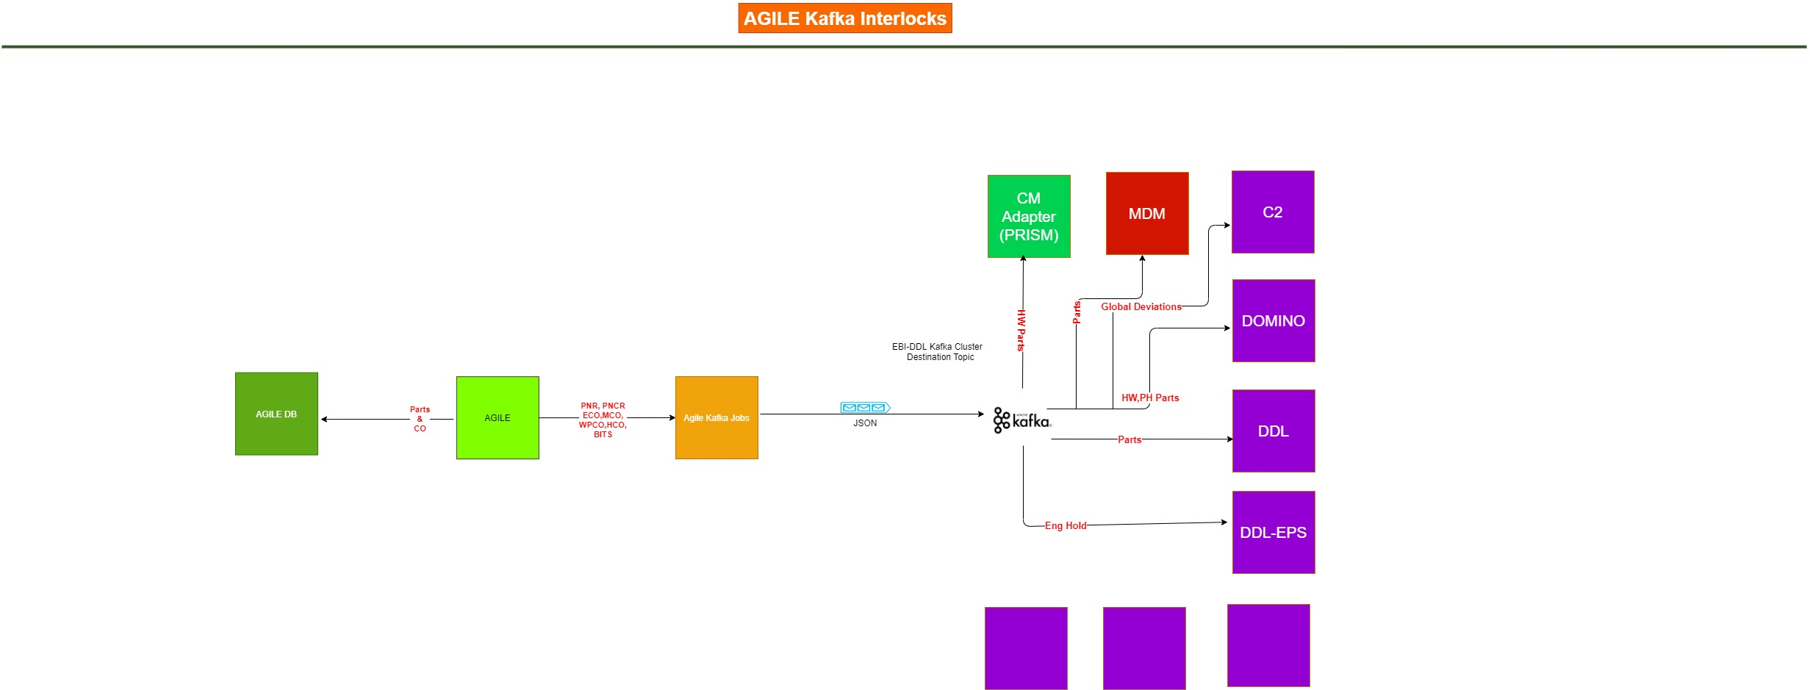

Slide 6
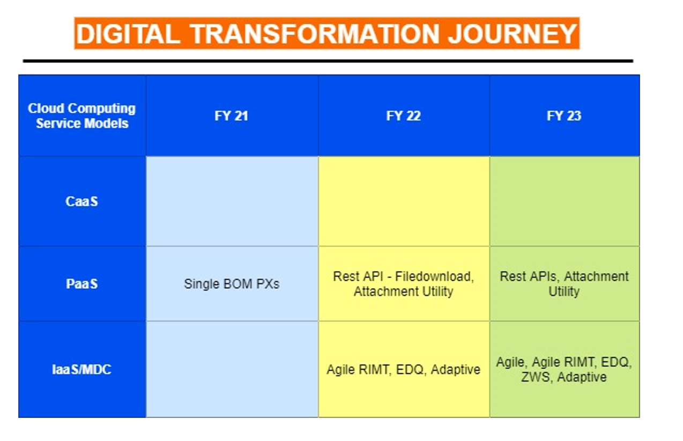

Slide 7
Key Business Benefits
Agile API service Layer
Service Account Authentication Maintenance replaced by Oauth2.0 Authentication feature provided by Market Place.
Automatic Scalable APIs thru PCF Deployments.
Addressing High latency issues and no response issues reported by Downstream Applications.
Making use of Monitoring and Metrics of all APIs from Market Place Portal.
Enable the Documentation of APIs using Stoplight documentation.
Implementing Generic APIs not tied to any downstream.
Asynchronous Response sent to Downstream Applications ACK API.

Slide 8
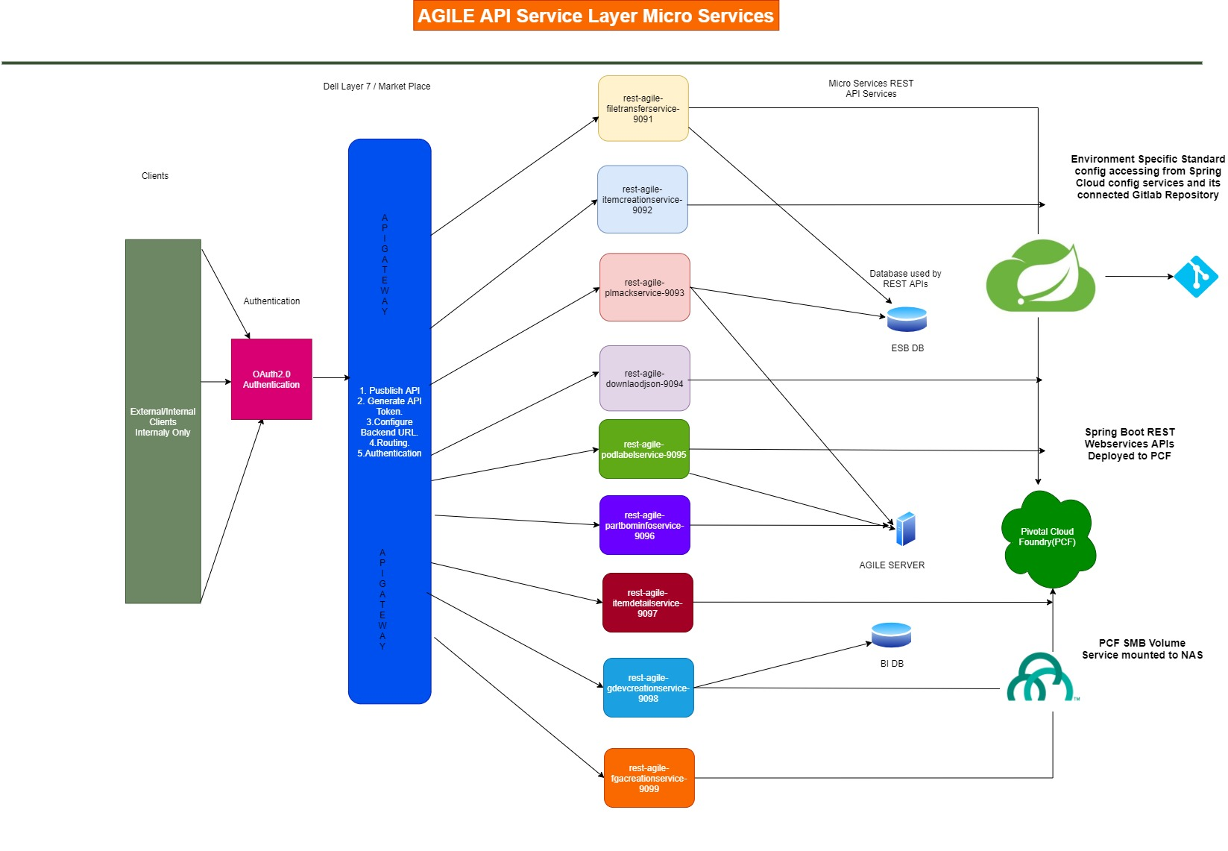

Slide 9
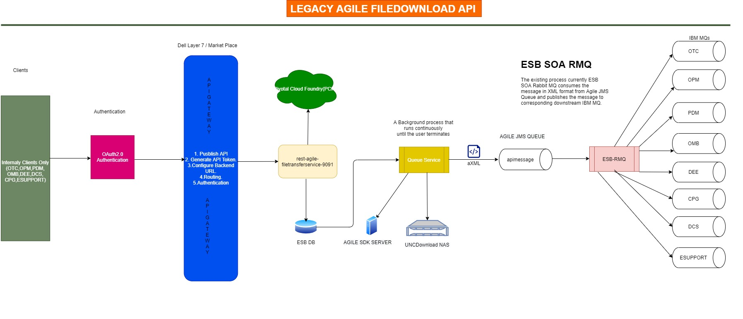

Slide 10
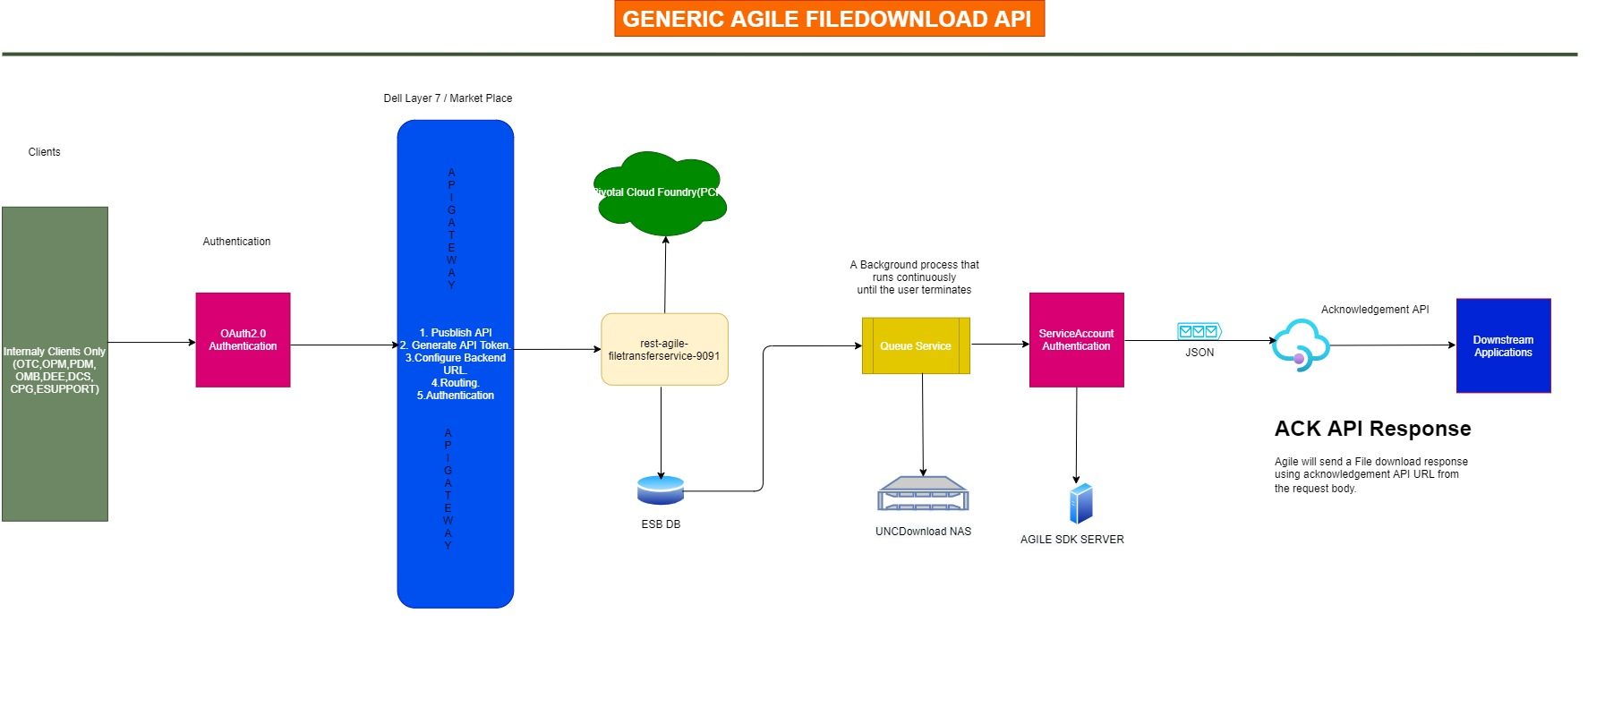

Slide 11
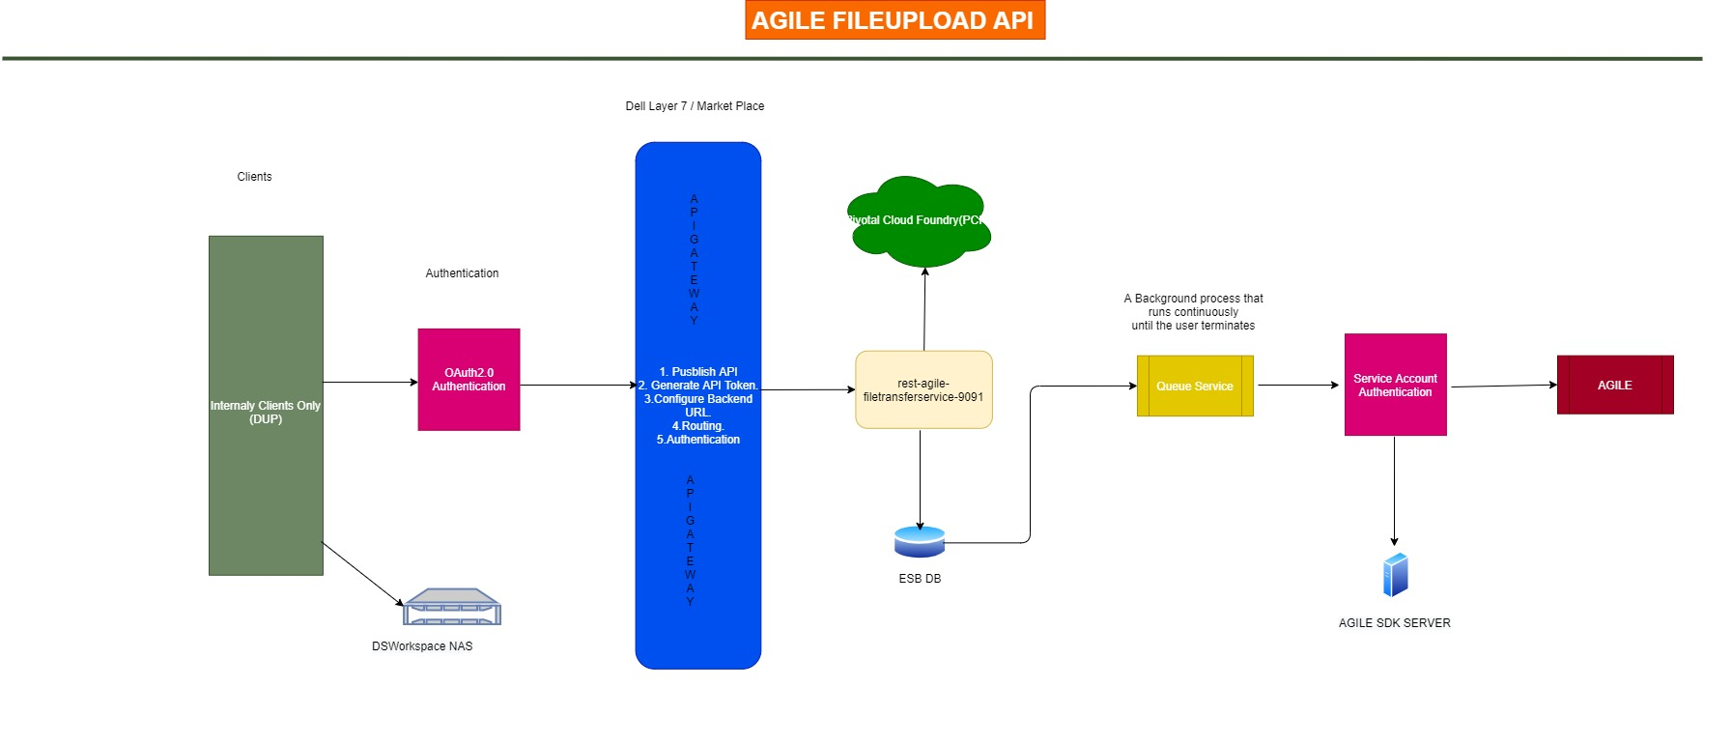

Slide 12
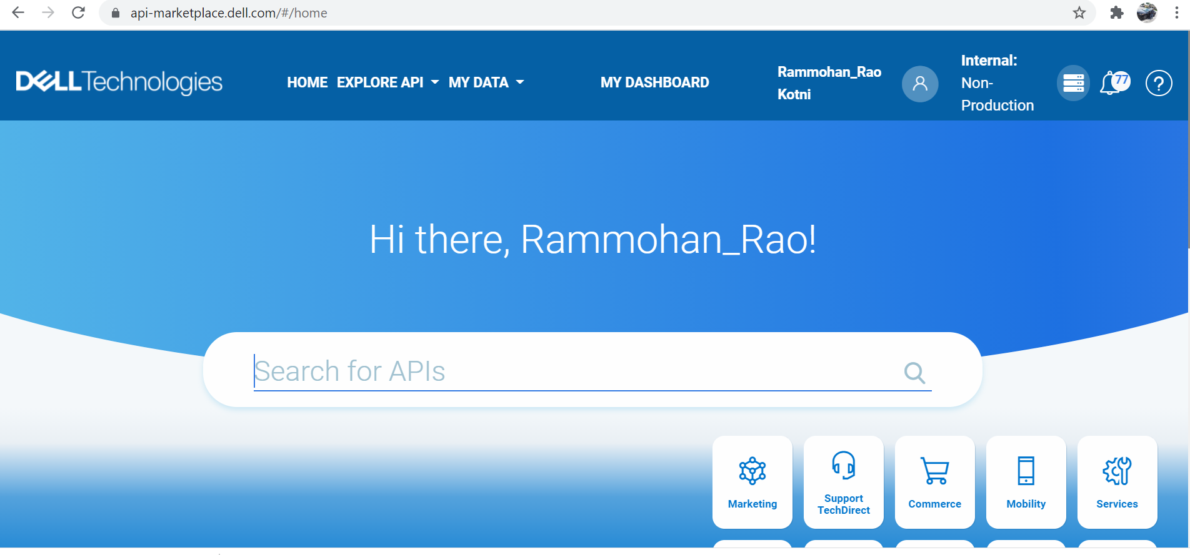
Market Place Integration

Slide 13
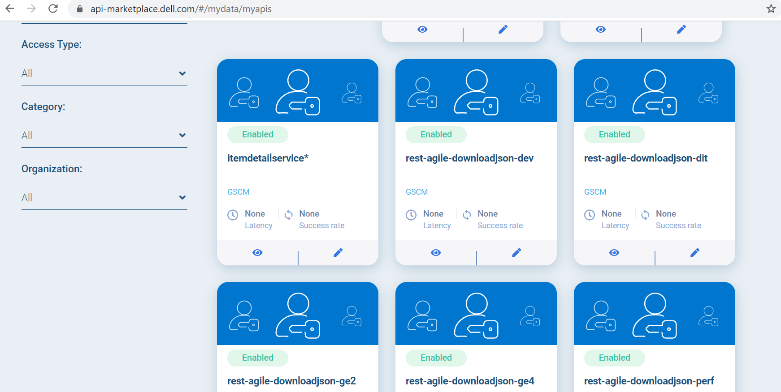
Market Place Integration

Slide 14
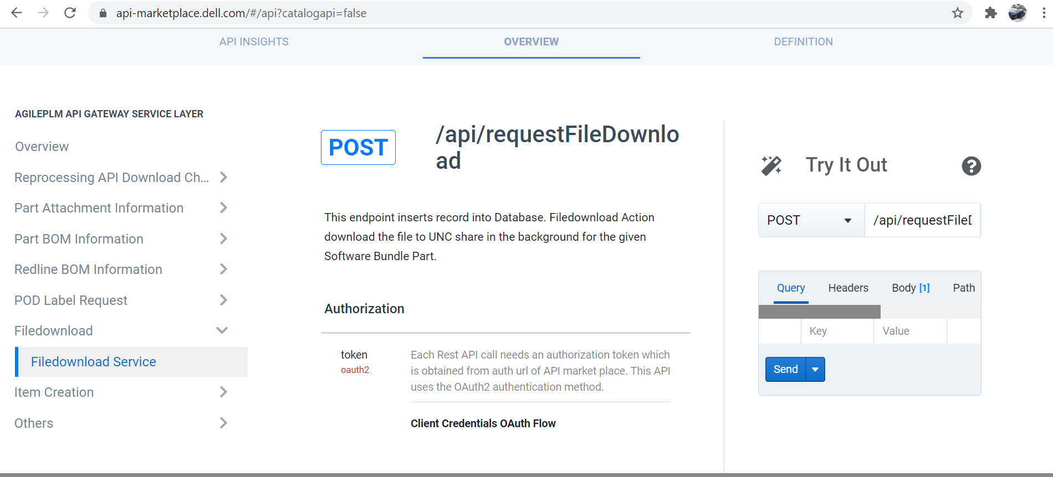
Stoplight documentation enabled in Market Place

Slide 15
Accelerated File Transfer Utility

Slide 16
Key Features
Digital Transformation
Migration to PCF.
Micro-service architecture.
Seamless integration with Agile, File Transfer Agent, NGINX,NAS,FC Server, McAfee and PCF.
Security
Anti-Virus scans for every file upload.
Removing the TLS1.0 communication dependency.
Reducing the number of UDP ports.
Secure File Transfer.
Technology
Latest File Catalyst Version – Transfer Agent 3.8.2.
Angular for User Interface.
Spring-boot for REST services.
McAfee Command Line Scanner for Virus scans.
NGINX servers for reverse proxy.
UI/UX
No dependency on the Java and Browser.
Implemented with Dell Design Library.
Integrated with Accessibility features, adhering to Dell standards.
Better feedback on File Transfer statuses.
Reducing the number of clicks by half per process in the UI.
Accelerated File Transfer Utility

Slide 17
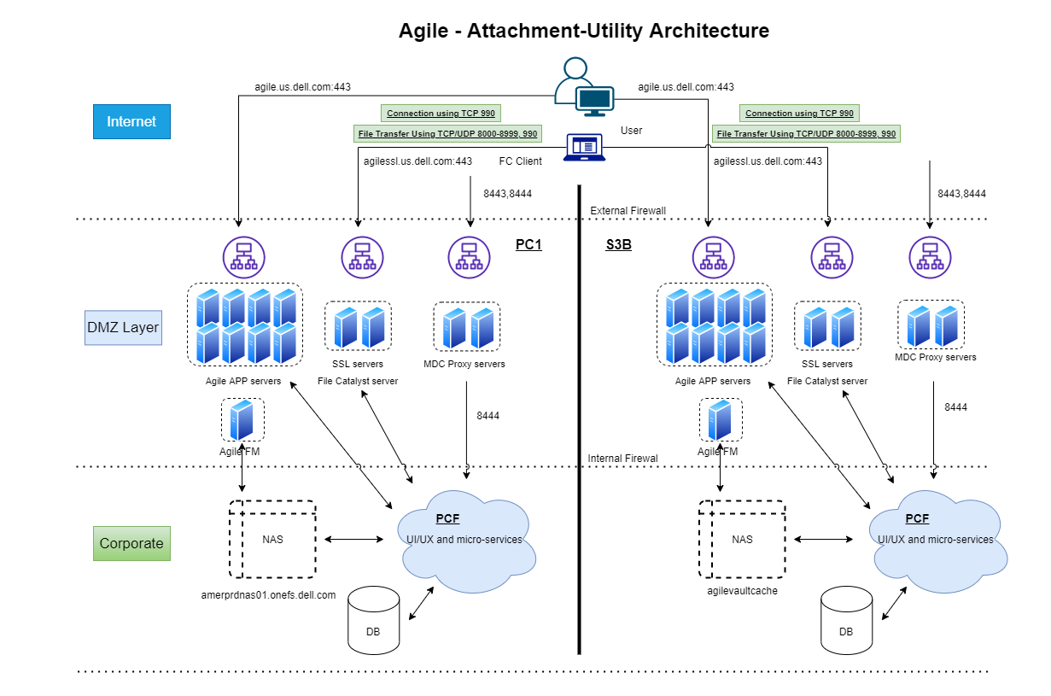
Architecture Diagram
Accelerated File Transfer Utility

Slide 18
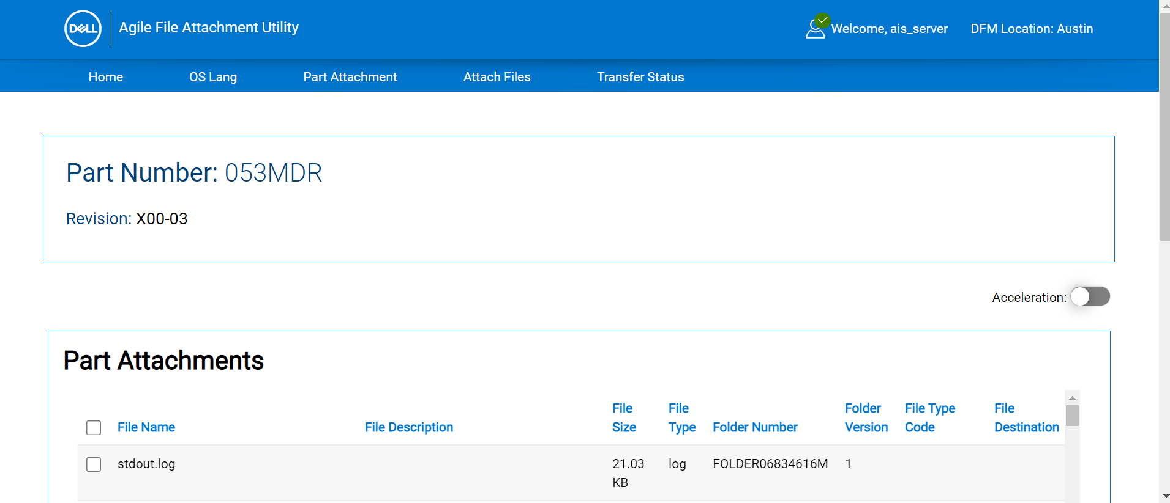
UI - Home
Accelerated File Transfer Utility

Slide 19
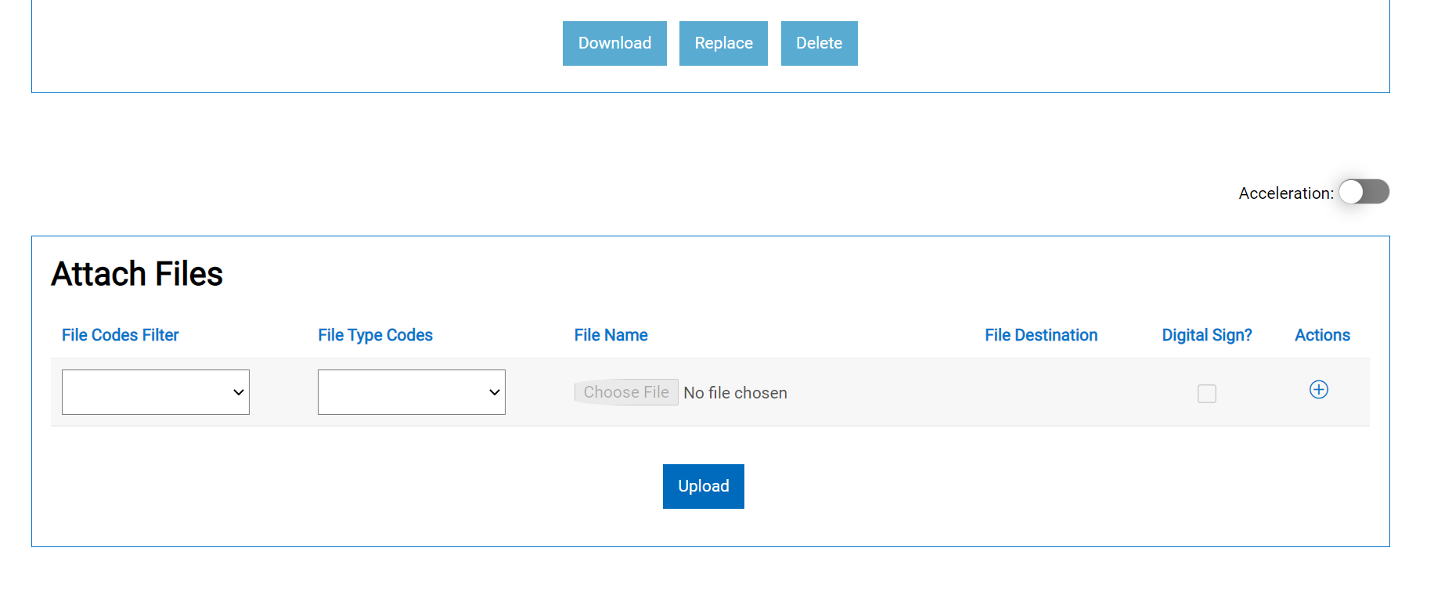
UI – Attach Files
Accelerated File Transfer Utility

Slide 20
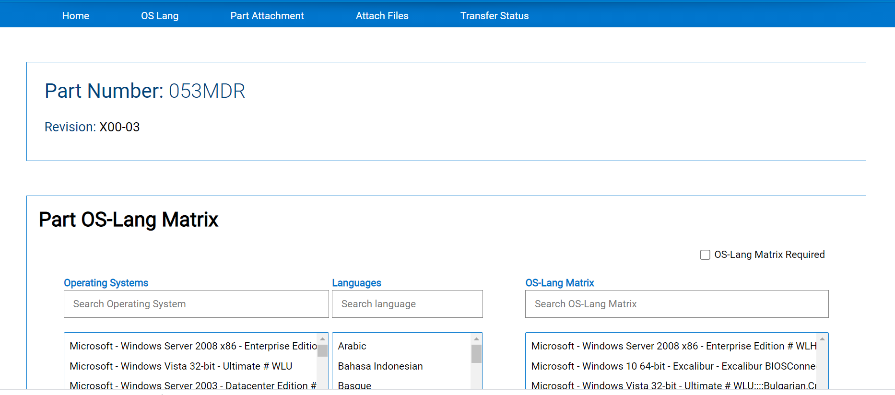
UI – OS Lang
Accelerated File Transfer Utility

Slide 21
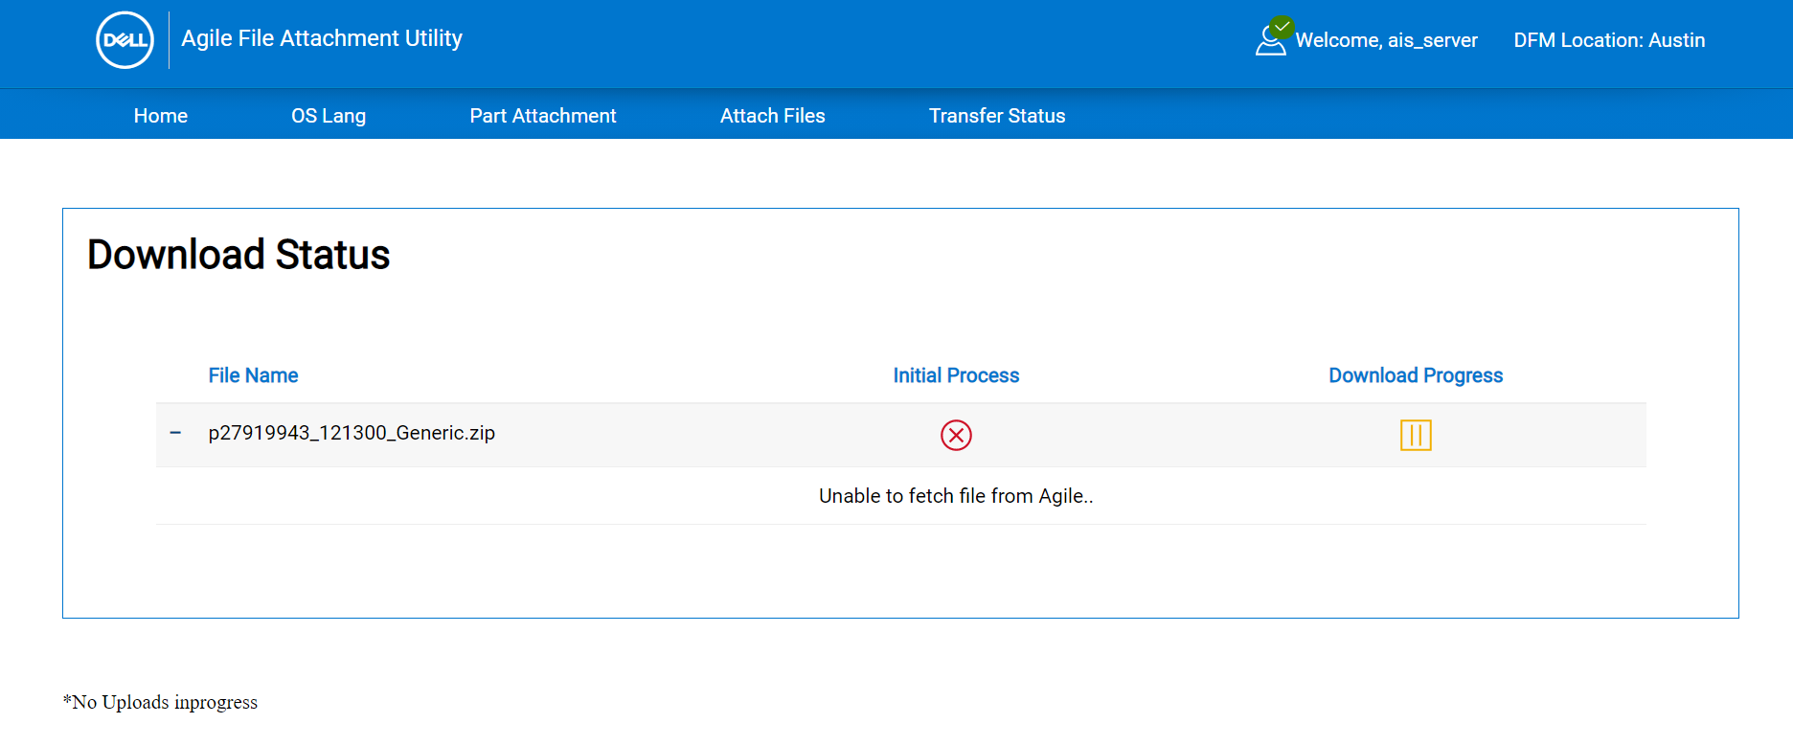
UI – Transfer Status
Accelerated File Transfer Utility

Slide 22
Thank You

